Slide 1
Why is Git/GitHub?
What changed, when it changed, who changed it, and why.

Slide 2
Which one is Final Version?
Model_v1.xlsx
Model_v1_new2.xlsx
Model_v1_new2_latest_FINAL.xlsx
Model_v1_new2_latest_FINAL_v3.xlsx
Model_v1_freq.xlsx
pricing_indication_FINAL.xlsx
pricing_indication_FINAL_REALLY.xlsx
RPM2026.xlsx
RPM2026_v2.xlsx
FINAL.xlsx
FINAL_v2.xlsx
FINAL_v2_LATEST.xlsx
FINAL_v2_LATEST_USE_THIS_ONE.xlsx
FINAL_v2_LATEST_USE_THIS_ONE2.xlsx

Slide 3
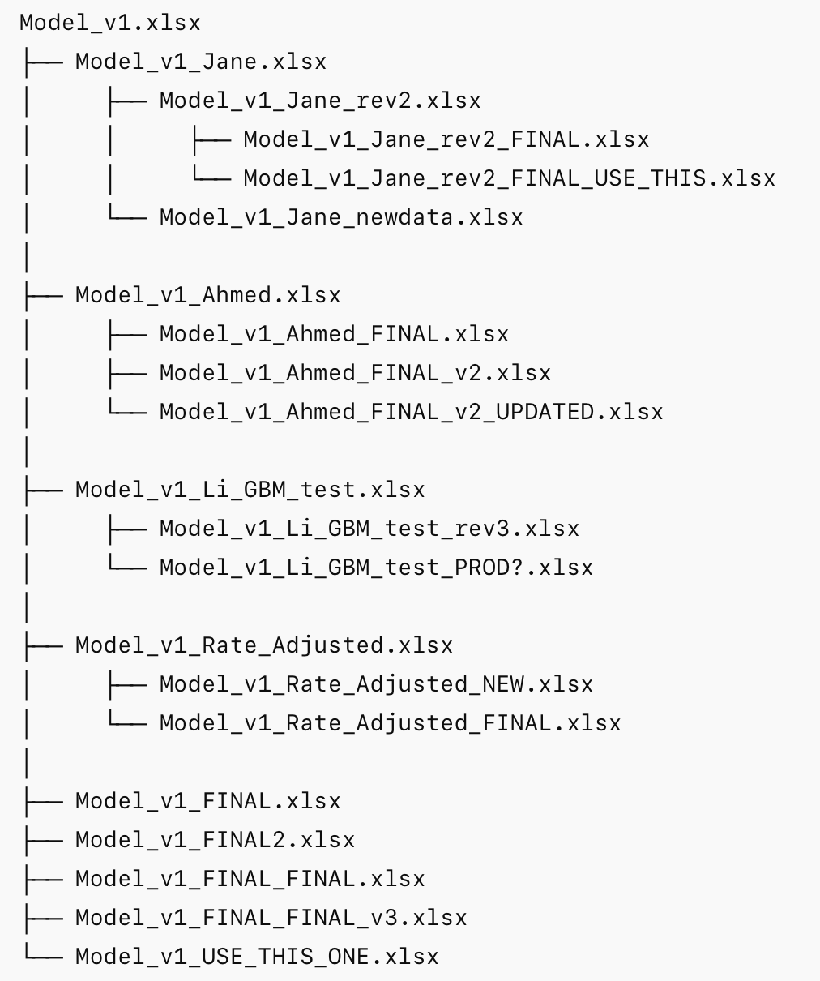
Which one is Final Version? V1

Slide 4
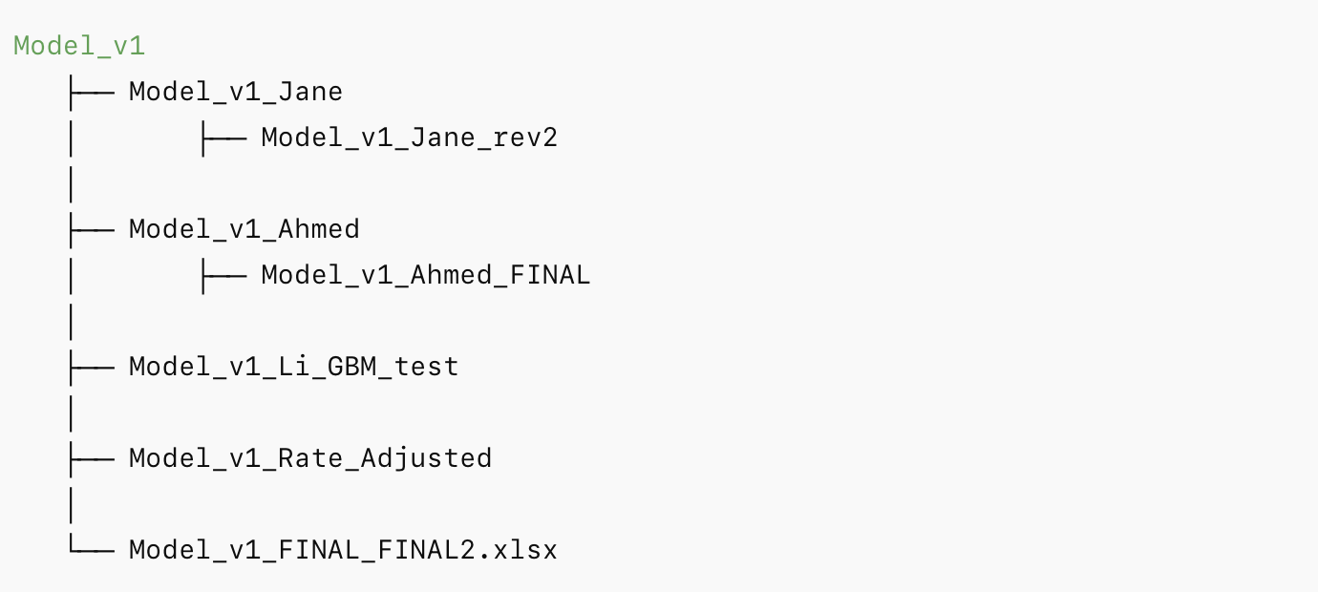
Which one is Final Version? V2

Slide 5
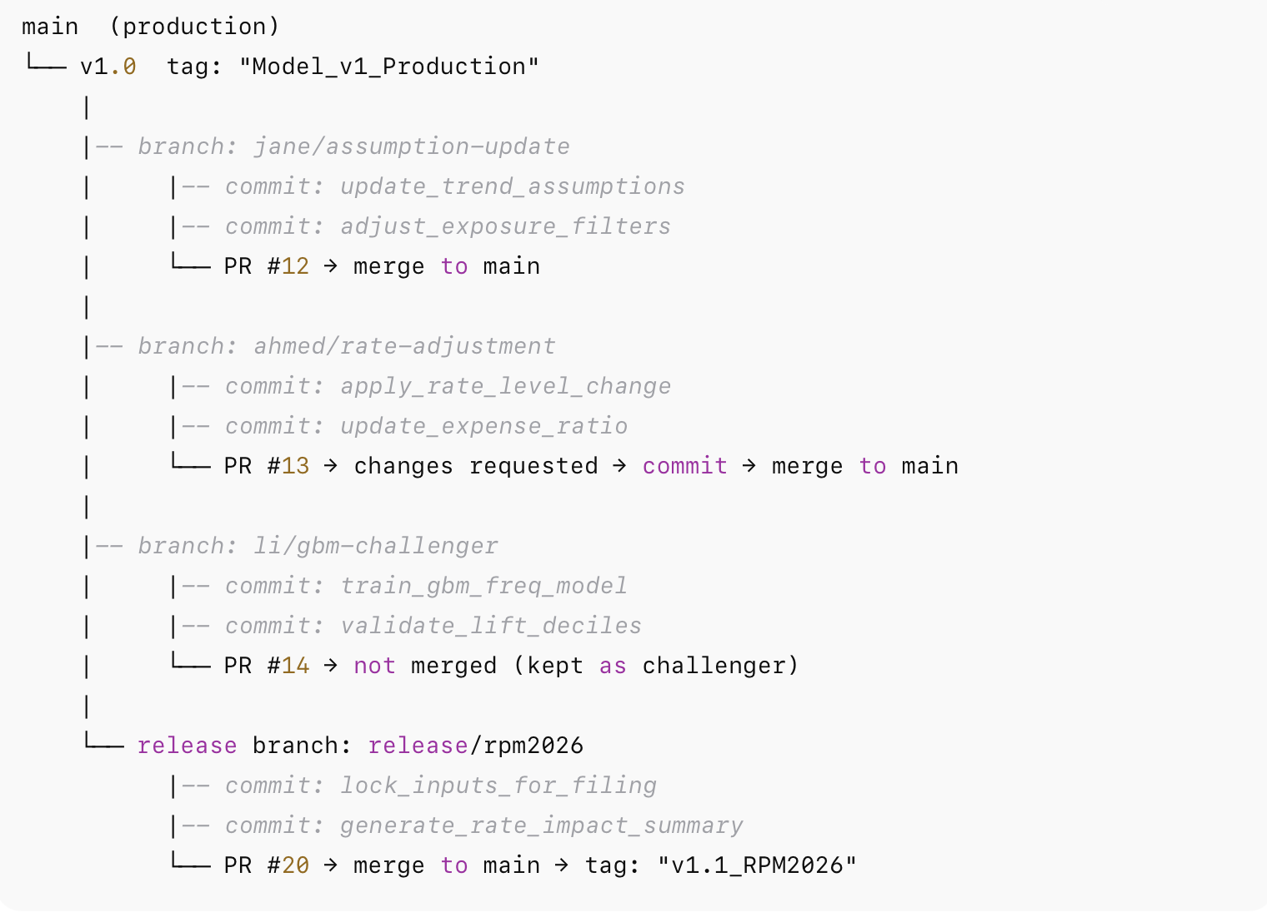
Which one is Final Version? Git style

Slide 6
What is Git/GitHub?
What changed, when it changed, who changed it, and why.

Slide 7
What is Git/GitHub?
GitHub is essentially a secure digital workspace where teams build, track, and improve projects together.
Think of it as: • A version-controlled vault • A collaboration platform • A governance tool • And a transparency engine
It stores code — but more importantly, it stores the history of decisions.

Slide 8
How Actuaries can Leverage Github
Audit & Governance
Controlled Innovation
Risk Management

Slide 9
How it Works
Three Simple concepts for GitHub:
Repository - Project Folder
Commit - Saved changes with Explanation
Branch - Safe testing Environment

Slide 10
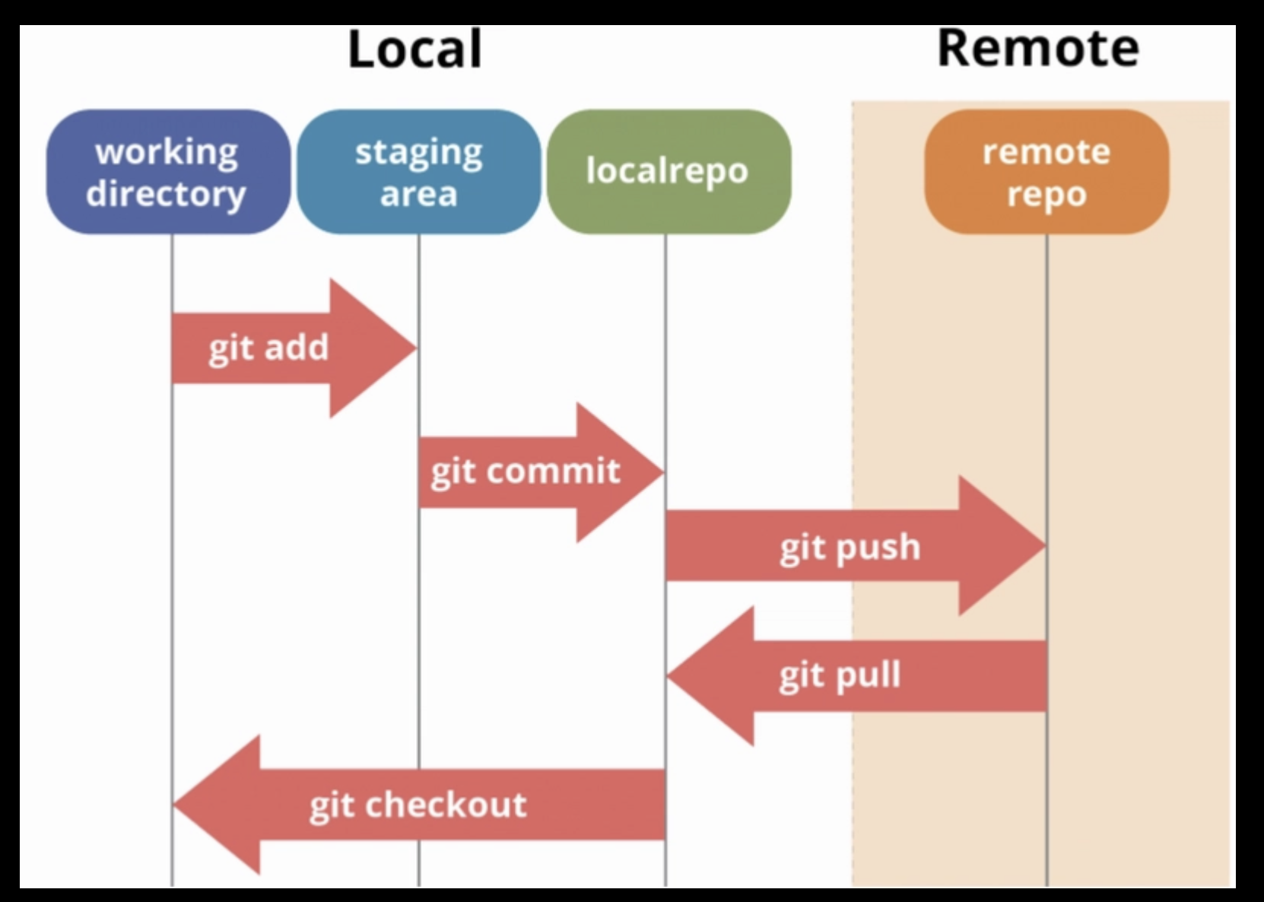

Slide 11
Git style way of working

Slide 12
Practical example ?

